Slide 1
Pro League of Legends Statistic Viewer
Austin Near
Alejandro Alcala

Slide 2
System Description
Our project shows data for professional League of Legends matches from 2015-2017 from all major regions excluding China
Users are able to filter matches by a variety of metrics
Users are able to view match and player data

Slide 3
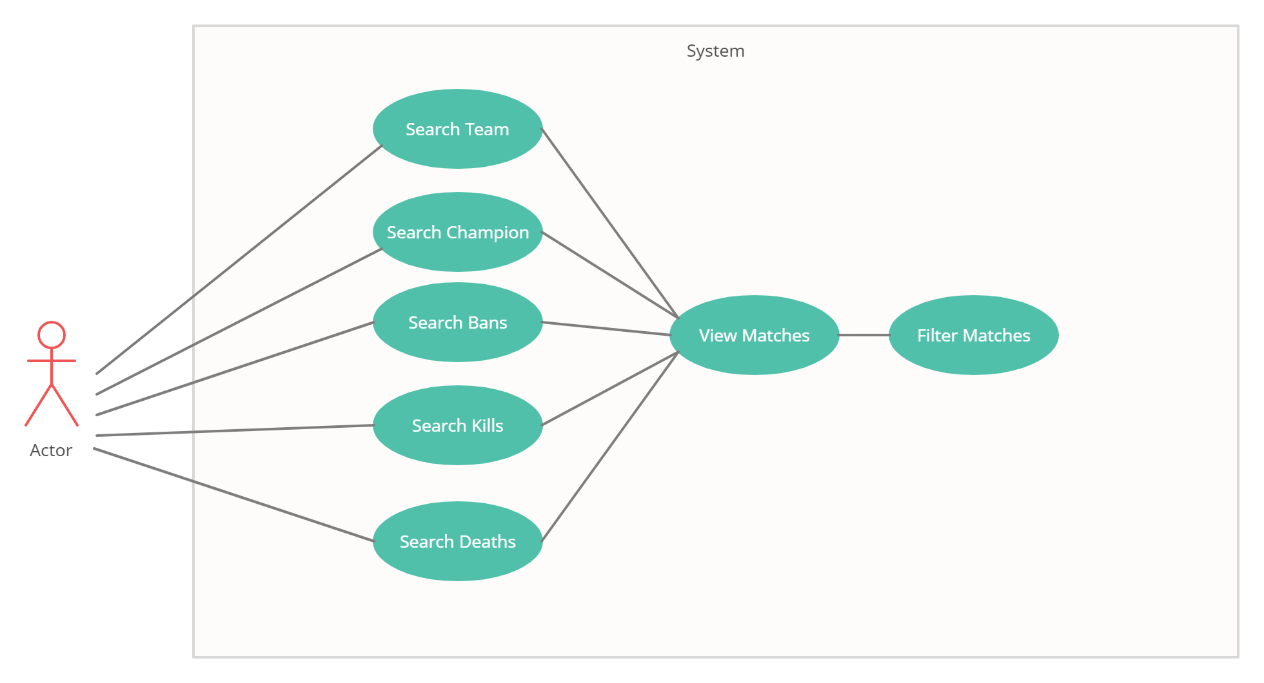
Use Case Diagram

Slide 4
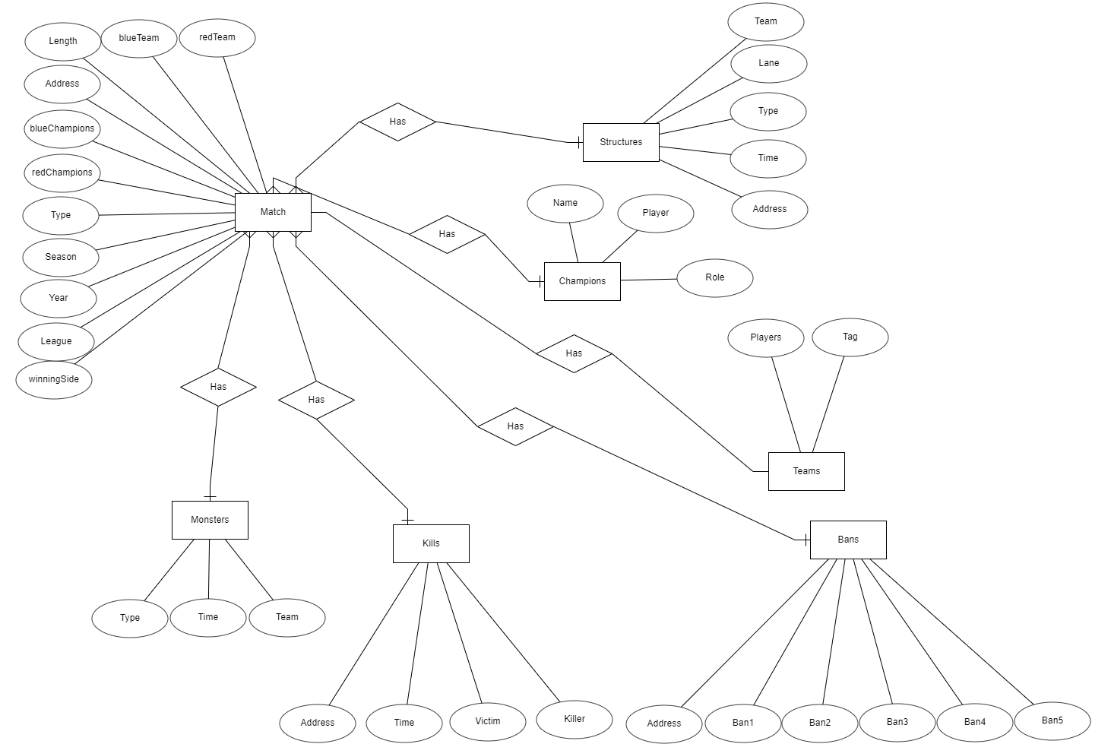
E/R Diagram

